Slide 1
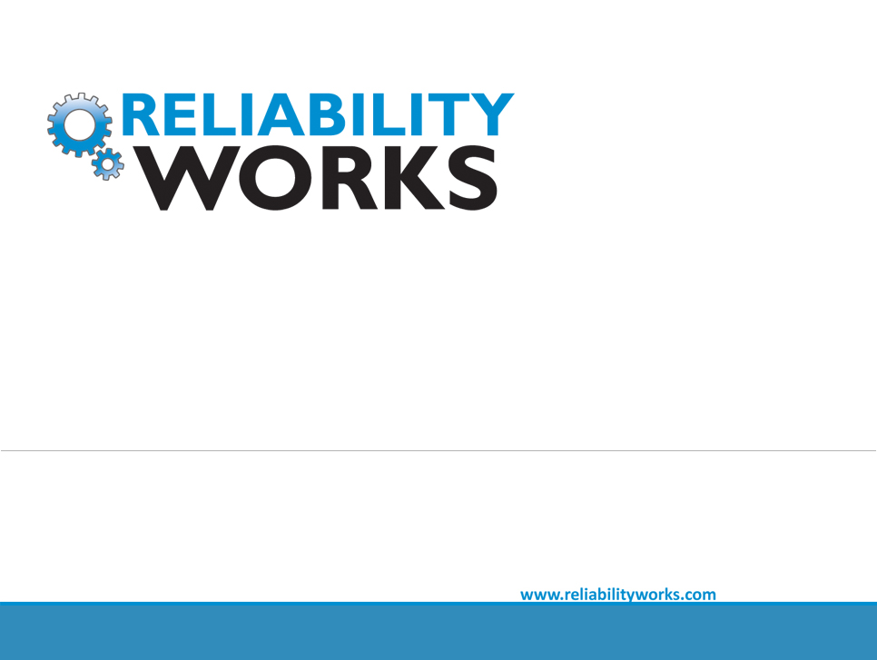
Reliability Analysis using Reliability Block Diagram( RBD)
ASQ RD Webinar Series
Reliability Works Incorporated
830-1100 Melville St
Vancouver B.C. Canada V6E 4A6
Presented by
Frank Thede, P.Eng
Principle Reliability Engineer
E: fthede@reliabilityworks.com
C: 780 722 0302
Roselia Moreno
Manager Reliability Engineering
E: rmoreno@reliabilityworks.com
C: 778 987 7959
Copyright Reliability Works Inc. © 2018

Slide 2
Reliability Block Diagrams
Webinar Outline:
General overview of Reliability terms and definitions
Introducing the Reliability Block Diagram (RBD)
RBD vs. Fault Tree
RBD analysis
  Inputs
  Outputs
  Application
Do I need a reliability analysis?
Examples (Case Studies)

Slide 3
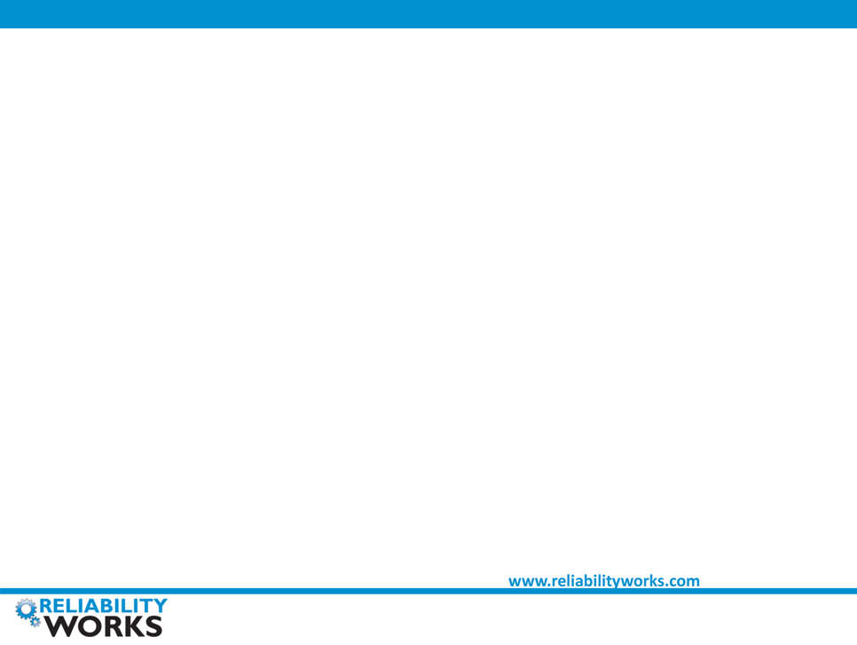
Reliability Basics – Terminology,
Definitions and Measures
Reliability in its simplest form …..
Reliability is the ability of equipment or system to operate without interruption for a desired period of time (mission time), under a given set of conditions
Notes:
Make the point that TIME is the key variable in reliability calculations. Performance over a time period.

Slide 4
Definitions
Any unplanned interruption to operating equipment or systems in delivering the desired performance is a failure.
Reliability methods aim to forecast failures through understanding the likelihood of failure occurrence in a given time.
Failures
Failures cost businesses money in lost production, repairs, safety hazards, environmental incidents, downtime, quality impacts and customer complaints.
The business of reliability is to reduce the losses caused by failures.
Costs/Risks
Notes:
Measures such as MTTF and MTBF are regularly used.

Slide 5
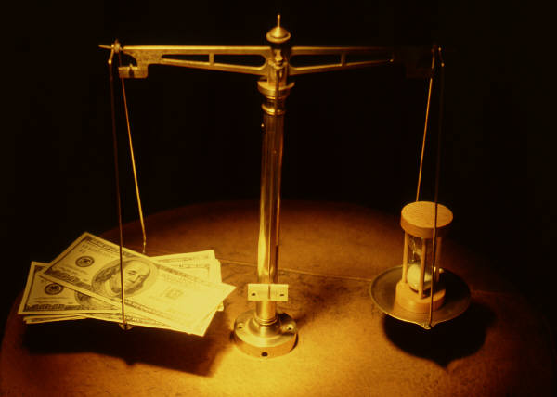
Definitions
High reliability costs money
Reliability Engineering aims to identify practical solutions to business issues
Understanding the needs of the business allows an affordable level of reliability through design, maintenance and support
Reliability
Engineering
Notes:
Make the point that some maintenance is done without assessing whether or not there is a significant impact to the business.

Slide 6

Definitions
Reliability and Availability are functions in time. The aspect of time is critical in their measurement and the key variables are:
Mission Time
Mean Time To Failure (MTTF)
Mean Time Between Failures (MTBF)
Mean Time To Repair (MTTR)

Slide 7
MTTR vs. MTBF
MTBF
MTTF
MTTR
MTTF
MTTR
When MTTR is small compared to MTTF, then MTTF can be assumed
to be the same as MTBF.

Slide 8
Definitions - Availability
“Is it available and functioning when I need it?”
Availability is the fraction of time that an item (component, equipment, or system) can perform its required function. It is used when working with repairable systems.
Availability is an important measure when system failure can be tolerated and repair can be carried out. It is represented by the expression:
The compliment of availability is the Unavailability represented by Q:
Q = 1- A
MTTF
MTTF + MTTR
A =
Notes:
Make reference to the impact of repair time on the availability.

Slide 9
Basic Reliability
The relationship between Reliability and MTTF is given by the expression:
    Reliability* = e ^{–λt}
Where λ = 1/MTTF
so…
Reliability = e ^{–t/MTTF}
Notes:
Emphasise this is suitable when failure rate does not change with time.

Slide 10
Basic Reliability
Suppose a Level Transmitter must operate for one year between turnarounds and the transmitter has a known MTBF = 8760 hours.
What is the system reliability?
R(t) = e ^{-(t/MTTF)}
R(8760) = e ^{-(8760/8760)}
= e ^{–1}
= 0.36788
= 36.8% chance of making it to
the next turnaround
Notes:
Illustrate how formula can be used. See if anyone surprised by result!

Slide 11
Reliability calculations
Suppose the same turnaround schedule and the transmitter has a MTTF = 87600 hours.
What is the probability of making it to the next turnaround without a failure?
R(t) = e ^{-(t/MTTF)}
R(8760) = e ^{-(8760/87600)}
= e ^{–.1}
= 0.90
= 90% chance of making it to the next
turnaround.
Notes:
What changed- not the equipment just your mission time! – Frank: please review this statement, I think the mission time has not changed (it is still one year, same turnaround schedule), what changed is the MTBF from 8,760 (previous slide) to MTTF = 87,600 hours.

Slide 12
Reliability calculations
Suppose a target for turnaround to turnaround reliability is 95%
What MTTF is required for the transmitter?
R(t) = e ^{-(t/MTTF)}
R(t) = .95 = e ^{-(8760/MTTF)}
1/.95 = e ^{(8760/MTTF)}
ln(1/.95) = 8760/MTTF
MTTF = 171000 = 19.5 yrs.
Notes:
Again can do the reverse and calculate MTBF – assuming steady state.

Slide 13
Reliability and Availability
Reliability ≠ Availability
Used when the system cannot be repaired
Used when the system can be repaired
Calculates probability the system will operate without failure
Calculates the fraction of time the system is available to perform its required function
Probability the system will operate for its defined lifetime/mission
Probability the system will operate on demand
Reliability Engineering uses/calculates either/both
Reliability Analysis is a general term to describe the process of estimating
System Reliability and/or System Availability

Slide 14
Reliability Engineering tools
  FMEA/FMECA Failure Mode Effect and Criticality Analysis.
  Fault Tree Analysis
  RBD’s Reliability Block Diagrams
  RCM Reliability Centered Maintenance
  Weibull data analysis and failure prediction
  RBI Risk Based Inspections
  RCA Root Cause Analysis
  LCC Lifecycle Costs
Tools
Notes:
These basic tools provide a framework to make decisions that impact on the business regarding failures. They are simple, systematic and require understanding of the principles of reliability engineering. They can be used by anyone in the organization and are extremely powerful where there is widespread buy. It provides a language to be able to talk about Problems and causes of failures, and their impacts on the business.

Slide 15
Reliability Block Diagram (RBD)
Tool to map the probable component failures and describe their relationship to each other and to the functionality of the overall system
It is drawn as a series of blocks connected in parallel or series, configuration. Each block represents a potential component failure within the system
In a series path any failure along the path will result in system failure
Parallel paths shows redundancy, meaning that all of the parallel paths must fail for the parallel network to fail

Slide 16
Reliability Block Diagrams (RBD)
Consist of blocks & nodes connected in parallel or series
Connections are used to represent success paths
Nodes are used to represent voting relationships
Blocks represent equipment failure modes, operator errors, environmental factor
Predicts system real life capacity, availability and reliability by considering:
    Failure rates
    Spares availability
    Redundancy
    Labour availability
    Equipment required
    Preventive and inspection programs

Slide 17
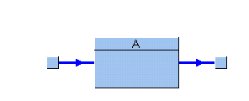
Reliability Block Diagrams
If A has an availability of 95%
then the system has an
Availability of 95%.
In the simplest System: the system is down if component A fails
Because there is no open path between input and output.
Notes:
consist of blocks connected in parallel or series.
connections are used to represent success relationships
nodes are used to represent voting relationships.
All blocks must be connected,

Slide 18
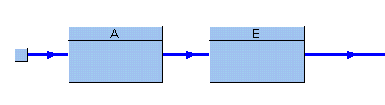
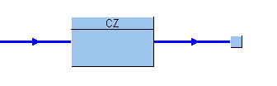
Reliability Block Diagrams
Lets say our system has 100 blocks in series and each block has an availability of 0.99.
….
input
output
1
2
100
What would the overall availability of this system be?
A _{S} = 0.99 ¹⁰⁰ =0.366 or 36.6%

Slide 19
Reliability Block Diagrams
Lets try our system with 3 components in parallel.
In this case, if any of the components fail the system is still up as there is still a success path from input to output.
System failure requires all three components to fail simultaneously.

Slide 20
Reliability Block Diagrams
Availability of simple parallel system
A = 1-(Q₁xQ₂xQ₃….Q_{N})
(Unavailability “Q” is equal to 1-Availability)

Slide 21
Reliability Block Diagrams
If availability of each block is 0.9 (Q= 1 – 0.9)
What is the availability of the system?
A = 1-(.1x.1x.1)=1-0.001=0.999

Slide 22
Reliability Block Diagrams
Most systems are more complex,
what is the system availability now?

Slide 23
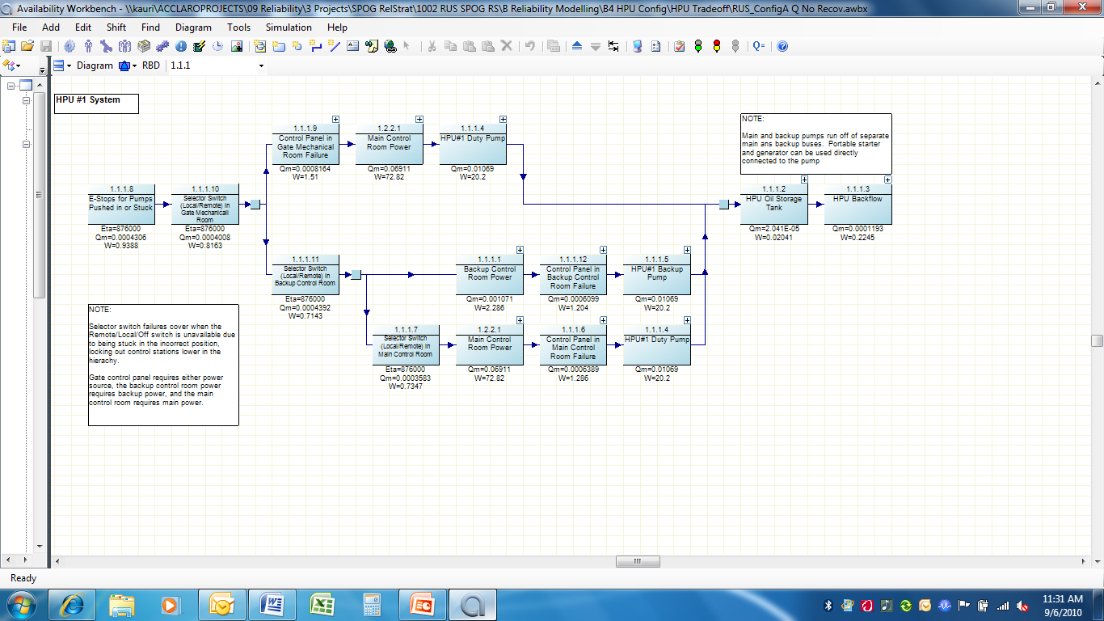
Reliability Block Diagrams
RBD Software Solution

Slide 24
Reliability Block Diagrams (RBD) vs. Fault Tree Diagrams (FTD)
Reliability Block Diagrams (RBD) and Fault Tree Diagrams (FTD) represent the logical relationship between sub-system and component failures and how they combine to cause system failures.
The most fundamental difference between the two tools is that when building RBDs, you work in the “success space” while building FTDs, you work in the “failure space”.
The RBD looks at success combinations while FTD looks at failure combination.
Fault trees have traditionally been used to analyze fixed probabilities (i.e. each event that composes the tree has a fixed probability of occurring) while RBDs may include time-varying distributions for the blocks' success or failure, as well as other properties such as repair/restoration distribution.

Slide 25
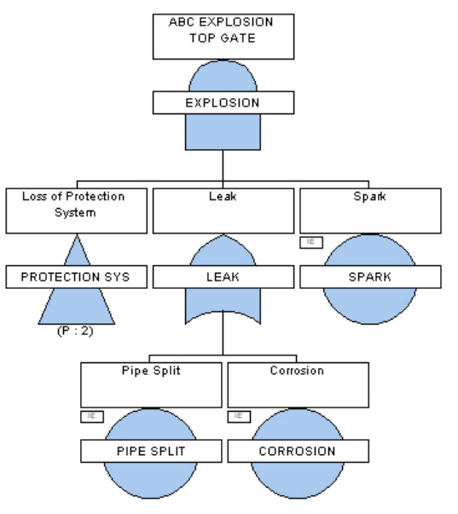
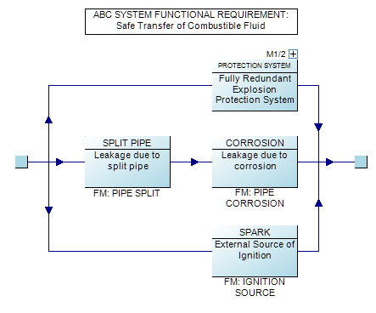
Reliability Block Diagrams (RBD) vs. Fault Tree Diagrams (FTD)
RBD looks similar to a process diagram or a schematic

Slide 26
Reliability Block Diagrams - Inputs
Quantitative inputs for each block can include:
  Failure rate (Q, MTTF, MTBF)
  Failure type (Rate, Normal, Weibull, Dormant…)
  Mean time to repair (MTTR)
  Common Cause Failure (CCF)
  System functional requirements
Data sources:
  Existing failure histories: failure rates, Weibull analysis
  Industry failure histories
  Operations, Field forces
  External databases: OREDA, NPRD

Slide 27
Reliability Block Diagrams - Outputs
Estimate System Unavailability (Q)
  Q=1.3x10⁻⁴ ~ Availability of 99.987%
Pareto chart analysis (failure mode importance):
  Sub-systems with largest contribution to unavailability
Sensitivity Analysis
  Manual intervention success rate
Assess high level design decisions:
  Refurbish vs. Replace
  Choose mitigation strategy:
  Redundancy
  Hardened design
  Proactive maintenance
  Testing frequency

Slide 28
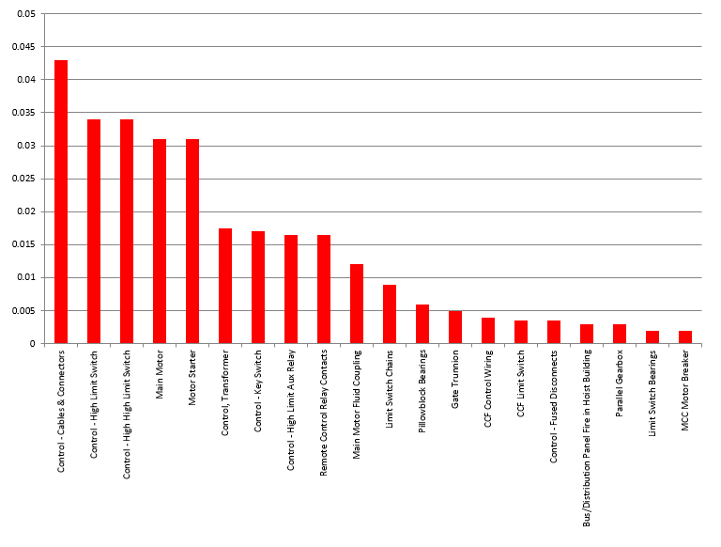
Begin with existing design – Pareto chart
Existing designs
Identify areas requiring improvement using Importance results from Reliability Model

Slide 29
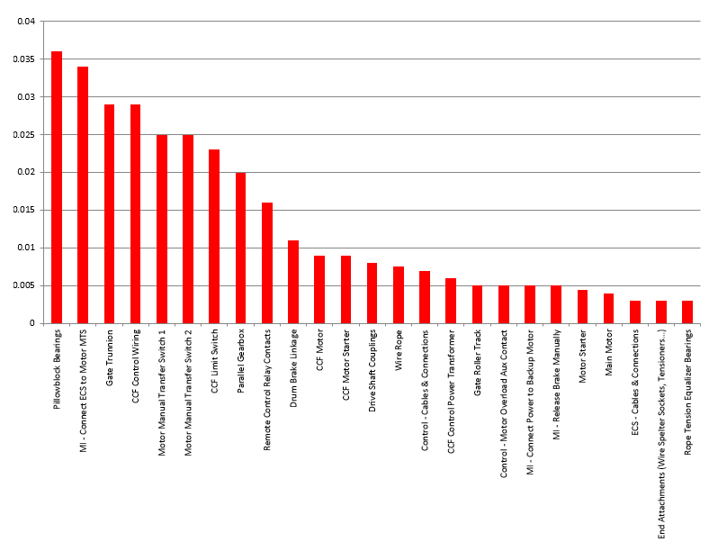
Evaluate Improved Design – Pareto chart
Proposed new designs
What opportunities are there to further improve performance?

Slide 30
Provide options
Estimating unavailability
Assess alternate designs
System model predicts performance (availability and capacity)
System model provides high level resource requirements (maintenance, labour and parts)
Modeling may uncover design solutions that are not viable
Sensitivity analysis is performed to understand the impacts of design options
“What If” – new solutions can be identified and tested (modeled) before implementation begins

Slide 31
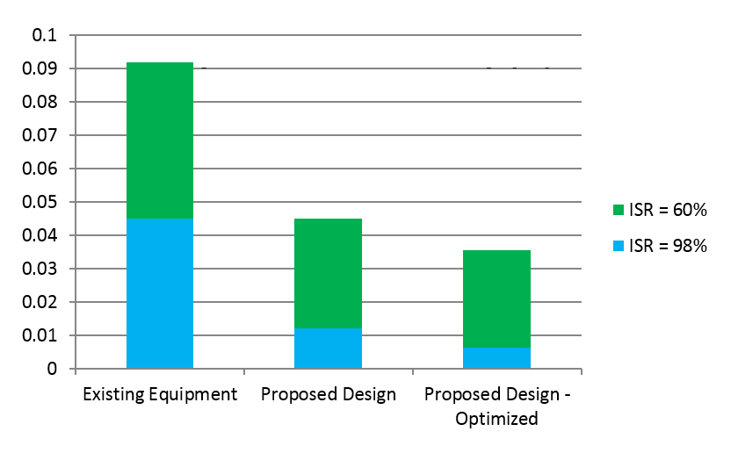
Optimized design outcomes (Q)
The model shows improvements in system unavailability for both assumed
intervention success rates (ISRs) of 98% and 60%.
Q

Slide 32
Reliability Myths (why do an analysis?)
Redundant systems always perform better
Increased flexibility for deploying back-up systems = greater availability
System reliability should be independent of operational requirements
Repair time for backup system is less important than for primary system
Component failure rates are equipment specific
Operating under design capacity = improved reliability
The better design becomes obvious with more experience

Slide 33
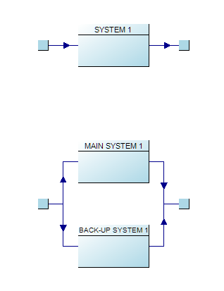
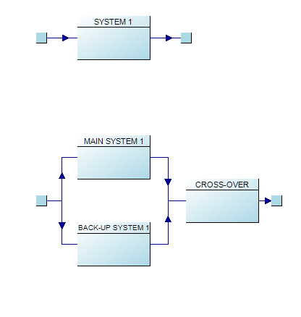
MYTH: Redundant Systems always perform better

Slide 34
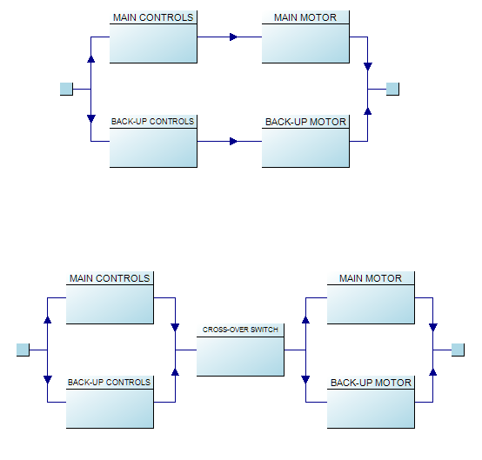
MYTH: Flexible/Configurable Systems Perform Better
Which is better?

Slide 35
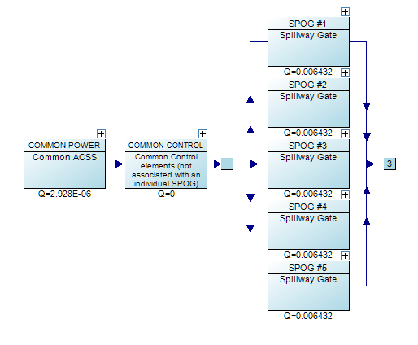
MYTH: System reliability should be independent of operational requirements
Functional requirements must be defined before the success path can be defined

Slide 36
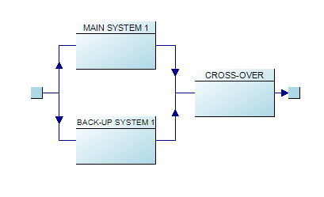
MYTH: Repair time for backup system is less important than for primary system
Availability = MTTF/(MTTF+MTTR)
Availability = 1 – [(Q1xQ2) + Qco]

Slide 37
MYTH: Component failure rates are equipment specific
Reliability in its simplest form …..
Reliability is the ability of equipment or system to operate without interruption for a desired period of time (mission time), under a given set of conditions

Slide 38
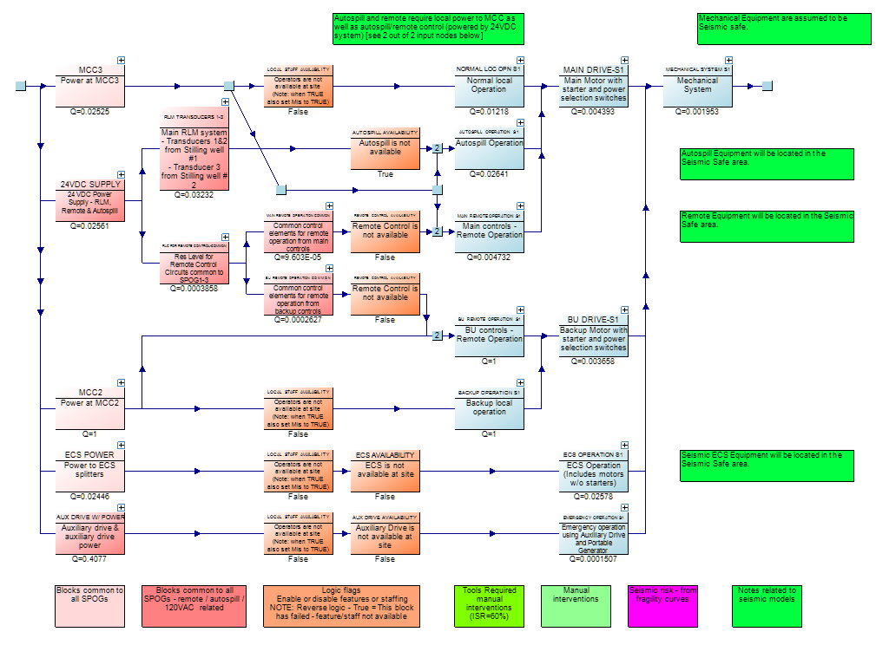
MYTH: The better design becomes obvious with more experience
Which is better?

Slide 39
If you want to know:
How available is the system
How Reliable is the system
How likely is a system failure
What design changes will yield the best performance
How much will it cost to test and maintain the system
How important is having spares on site
What level of performance can I guarantee
What’s the risk of environmental damage
What’s the safety risk
Do the analysis

Slide 40
How does reliability assessment change the process to find a solution for an under-performing system?
Traditional approach
System
under-performing?
NO
Identify problem
Initiate
Capital project
Re-assess performance
Is the
system performing?
Identify
& select
solutions
Implement solution
YES
System performs.

Slide 41
Reliability based approach
System
under-performing?
Identify Major Contributors
Understand system requirements and performance
gaps
NO
Identify
& select
solutions
Model
system performing?
Assess performance
YES
Initiate Capital Project
Implement solution
System
performs.

Slide 42
Reliability Analysis using RBD – Examples:

Slide 43
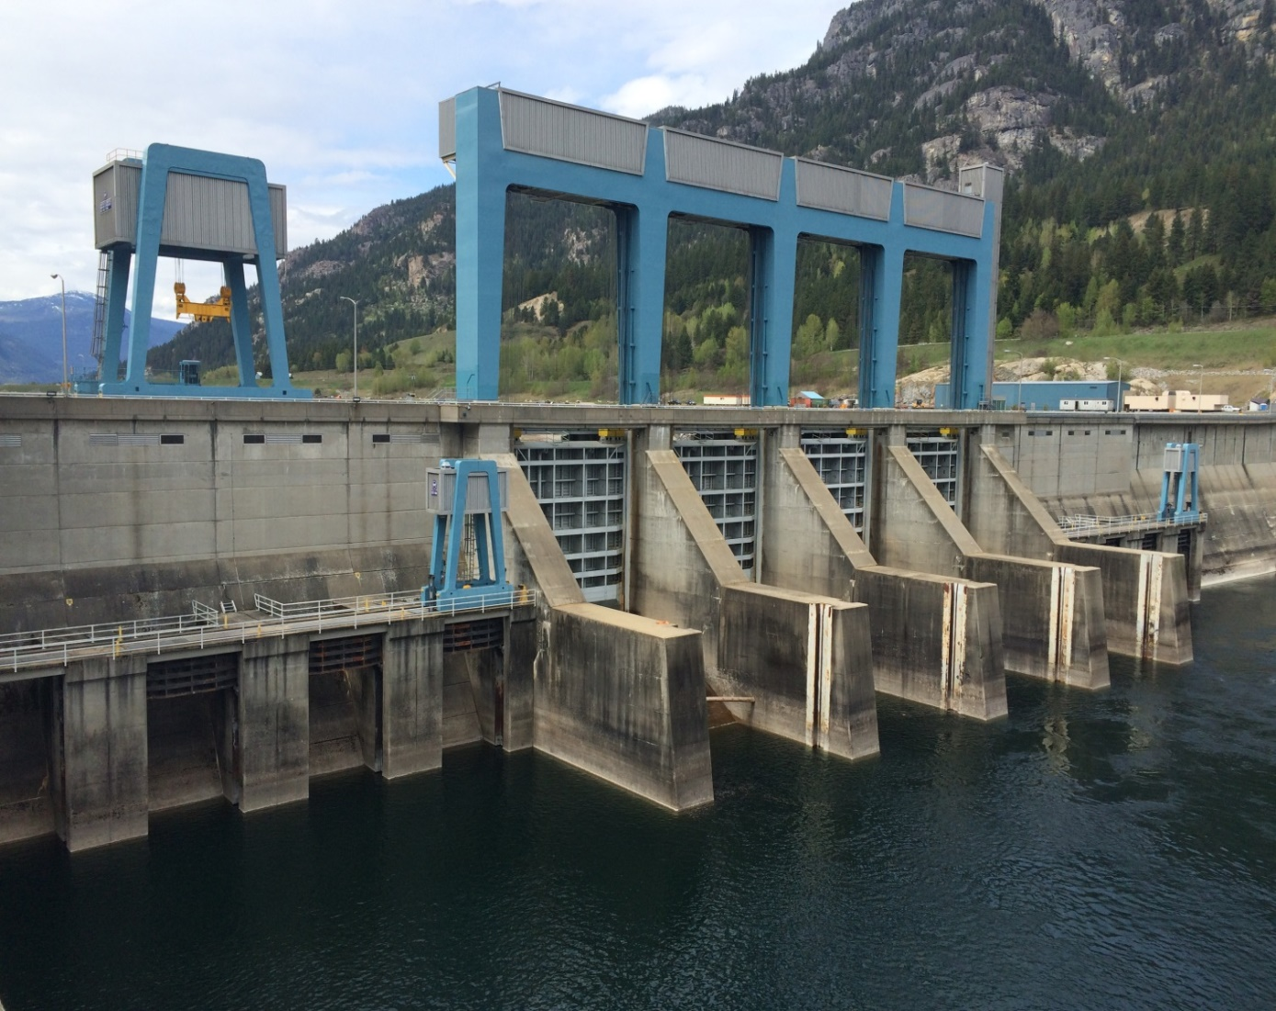
Case Study – Spillway System
Site condition:
Full Remote operation
6 hours response time
Staffing: business hours
Analysis Impact:
Redundant Gate
(safety objective)
Optioneering:
Simplified Power Configuration ($750K)
Eliminated an automatic transfer switch ($600K)
Simplified Control ($500K)

Slide 44
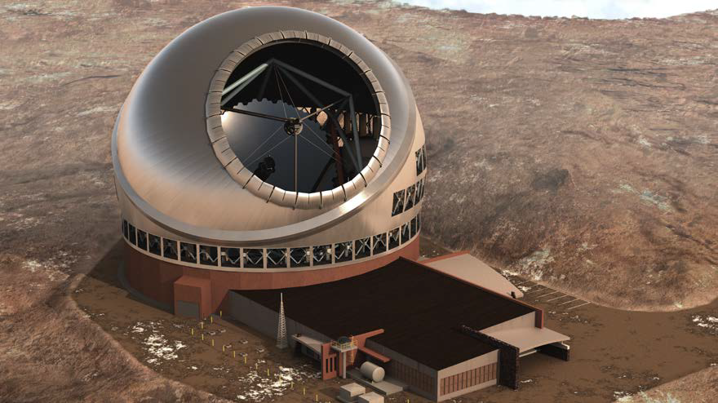
Case Study – Telescope Observatory System
Challenge:
Confirm reliability targets proposed in the conceptual design
Method:
RBD was used to model the system for two mode of operation:
Normal Operation and Degraded Operation
Results:
Overall unavailability of the system from RBD confirmed targets proposed by the conceptual design however unavailability of individual subsystem varied significantly – efforts to improve design were realigned.

Slide 45
THANK YOU

